Slide 1

Equal Opportunity & Nondiscrimination
Investigator Training
Human Resources Division
August 6-7, 2025
MinnState.edu

Slide 2
Training Orientation
Schedule:
  Wednesday, August 6, 2025 (1:00 PM to 4:00 PM)
  Thursday, August 7, 2025 (9:00 AM to 2:00 PM)
Audience:
  1B.1 and 1B.3 Investigators
  Title IX Coordinators
  Designated Officers
Training materials: SO-Investigators and Decisionmakers Team

Slide 3
Training Orientation, cont.
Participants are on Zoom and in-person
  Attendance
  Remote point of contact
  Recording prohibited
Be present and attentive
Reduce and/or eliminate interruptions and distractions
Engage in prompted activities
Take notes

Slide 4
Outline of Today’s Presentation
Brief review
Investigation Techniques​
Notes:
This is our outline for the topics we’re going to cover in today’s presentation

Slide 5
Scenario: Taylor
Taylor, a student, met with the Accessibility Resource Coordinator two weeks before classes started, providing the necessary paperwork. Taylor received a letter from the Coordinator with her accommodations, which she provided to Dr. Trowbridge, one of her professors. Taylor received an email from Dr. Trowbridge, who stated that Dr. Trowbridge didn’t believe the accommodations were necessary for Taylor to take the course, and if Taylor disagreed, Taylor should withdraw from the course.
Protected class(es)
Unwanted conduct
Evidence conduct is based on protected class(es)
Negative effect

Slide 6
Scenario: Chloe
Chloe, a faculty member in the Accounting Department, is approached by the recently hired Dean, Alton, who asks whether she was “born a man” because he had heard a rumor that “there was a transvestite in the department.” Chloe disclosed to Alton that she is transgender and asked him to keep this information confidential. After this conversation, Alton instructed Chloe to wear pants while on campus because a dress would be “inappropriate,” despite other faculty members wearing dresses and skirts. Alton also asks inappropriate questions about Chloe’s anatomy and sexual relationships. Further, whenever Alton is frustrated with Chloe, he misgenders her by using, with emphasis, “he/him” pronouns, sometimes in front of other faculty and students in the department.
Protected class(es)
Unwanted conduct
Evidence conduct is based on protected class(es)
Negative effect
Source: adapted from EEOC Guidance

Slide 7
Scenario: Ferguson
Ferguson, a student, made a report to his advisor. Ferguson admitted to sharing pictures of himself with another student, including some nudes. Ferguson tried to tell the other student that he was no longer interested in spending time with them when they stated they would share Ferguson’s pictures in a group chat, associated with a campus student organization, that two are members of. Ferguson is anxious about leaving his room and doesn’t feel like he can go to class.
Protected class(es)
Unwanted conduct
Evidence conduct is based on protected class(es)
Negative effect

Slide 8
Scenario: Steve
Recently, Steve served as a witness in a 1B.1 investigation where he made negative comments about Selena, a supervisor in another department who was the subject of the investigation. Neil, who works on many projects with Selena and is Steve’s supervisor, has since started to make comments in their 1:1 meetings, questioning Steve about his “fit” at the campus and his long-term plans. Steve had an evaluation completed this week that included statements about poor performance, which is significantly different from his past four reviews.
Protected activity
Materially adverse action
Causal relationship between activity and action

Slide 9
Designated Officer Tasks
Jurisdiction and scope
Conflicts of interest
Interim actions re: health, safety concerns
Primary person to ensure process moves forward through each relevant step of the procedure
Release of information requests

Slide 10
Investigator Tasks
Conducts a fact-finding inquiry or investigation of the complaint, including scheduling and holding interviews and requesting record information; may delegate this to another trained investigator
Informs involved parties of right a union representative or support person to accompany them during investigative interviews, as appropriate
Informs involved parties of the protection and prohibition of retaliation per policy
Creates, gathers, and maintains investigative documents as appropriate

Slide 11
Investigator, Continued
Writes investigation report with organized attachments
Outlines facts in the investigative report based on information collected through the interview process and review of gathered documents
Primary person to ensure process moves forward through the investigative steps
Handles all data in accordance with applicable federal and state privacy laws, consulting with the campus Data Practices Officer when necessary
Provides all investigative materials to the Designated Officer for recordkeeping

Slide 12
The Investigation
Provides enough information for the decisionmaker to make a reasoned decision about whether policy has been violated
Maintains integrity of process
  Timely
  Fair to both parties
  Provide confidentiality as required by law
  Thorough
  Tailored to individual circumstances
Provides findings of facts, not findings of policies

Slide 13
Decision-maker Tasks
Determines whether there is any real or perceived conflict of interest
Receives and reviews the investigation report
Provides notice to the Complainant and Respondent regarding receipt of report, their role as Decisionmaker, and anticipated timeline for decision
Makes sure the investigator has complied with Minnesota State procedures
May meet with parties or request additional information from the investigator

Slide 14
Decision-maker, concludes process
Decides whether policy has been violated based on information provided in report
Writes reasoned decision based on facts, available information, and policies
Provides decision letters to complainant and respondent of their findings regarding a policy violation; copy to the Designated Officer
Provides all related report materials to the Designated Officer for recordkeeping

Slide 15
Decision Factors
Weigh evidence and evaluate credibility
Consider the totality of circumstances
  History of complaints/grievances
  Treatment of others (those who are different and those who are similarly situated)
  Skills/competencies of supervisors demonstrated by past actions
What is more convincing, more credible, and has greater probability

Slide 16
Relevant Evidence
For 1B.3/Title IX
Evidence is generally considered relevant when it helps determine:
  Whether the Respondent violated policy, and/or
  The credibility of any evidence, including a party or witness statement
The Investigator initially evaluated relevance, but the DM ultimately decides
All relevant evidence must be objectively evaluated and considered
  Inculpatory: tending to suggest a finding of responsibility
  Exculpatory: tending to suggest a finding of not responsible
In the decision-making phase, parties may dispute the Investigator’s initial relevance determinations

Slide 17
Relevant Evidence Exclusions
For 1B.3/Title IX
Evidence of the Complainant’s sexual predisposition is never relevant
Evidence of the Complainant’s prior sexual behavior is not relevant except:
  If offered to prove that someone other than the Respondent committed the alleged conduct; or
  Specific incidents of the Complainant’s prior sexual behavior with respect to the Respondent offered to prove consent
Exclusions apply even if admitted or introduced by the Complainant
Exclusions do not apply to the Respondent’s prior sexual behavior or predisposition, which are admissible if relevant

Slide 18
Credibility Considerations
Assessing and determining credibility is an important DM role
Credibility is often a function of corroboration and consistency
Credibility does not necessarily equate to honesty or truthfulness:
  Believability does not equal truthfulness
Credibility impacts the reliability of evidence and its weight
Specific credibility issues that a DM may consider:
  Relationships between the parties and witnesses
  Whether a witness was exposed to information (e.g. in the case of a parent or Advisor) that may have influenced their testimony

Slide 19
Credibility: Parties and Witnesses
Credibility impacts likeliness
  Would a reasonable person do the same?
  Are there more likely alternatives?
Credibility Assessment involves evaluating whether evidence is believable and reliable
  Refrain from focusing on irrelevant inaccuracies and inconsistencies
NOTE: Memory errors alone do not necessarily diminish witness credibility, nor does some evasion

Slide 20
Deciding if Misconduct Occurred
Standard of proof in determining a 1B.1 and 1B.3 violation
  Preponderance of evidence; i.e. more likely than not to have occurred
  Secondary information has value
  Reasonable inferences also are used
Insufficient Information
Clear and Convincing
No Evidence
Preponderance of the Evidence
Beyond a Reasonable Doubt

Slide 21
Scenario: Appeal
Aiko, the Complainant of a 1B.1.1 investigation, filed an appeal of the decision for no policy violation, stating two major concerns: 1) not all of the witnesses that she identified were interviewed, to which she provided written statements from them, and 2) that she believes the investigator was biased; she noted how the investigator asked questions, often following up her answers with, “are you sure that’s how it happened?”
Right to appeal?
Grounds for appeal
  Procedural irregularity, affected decision
  New evidence, not reasonably available before
  Conflict of interest or bias
  Insufficient evidence for decision

Slide 22
Procedure Overview 1B.1.1
Complaint to Designated Officer
Resolution path
Investigation
Write investigation report
Designated Officer reviews Report
Decision
Appointed investigator
Report goes to OGC & DM
DM reviews report
DM provides draft letters to OGC; consults re findings
DM authors & sends decision letters
Refer
Informal
Formal: investigation
Appeal
For both complainant and respondent
Appeal Decision-maker appointed
Review of appeal submission
Consult with OGC
Author & send decision letters
Final decision
CBA: Grievance
Student: CH 14
DM= President
Conduct interviews
Gather evidence

Slide 23
Procedure Overview 1B.3.1
Complaint to Title IX Coord.
Resolution path
Investigation
Write investigation report
Title IX Coord. reviews Report
Decision
Appointed investigator
DM provides draft letters to OGC & TIXC; consults re findings
DM authors & sends decision letters
Refer
Informal
Formal: investigation
Appeal
For both complainant and respondent
Appeal Decision-maker appointed
Review of appeal submission
Consult with OGC
Author & send decision letters
Final decision
CBA: Grievance
Student: CH 14
DM= President
Conduct interviews
Gather evidence
Formal Hearing
Report goes to parties & DM
Formal hearing with hearing administrator

Slide 24
Investigation Skill-building
Maegen Sincleair Usher, JD (she/her)
Investigation Specialist & Lead Deputy Title IX Coordinator
Metro State University

Slide 25
Part 1: Investigation Strategy

Slide 26
Investigation Scope
Scope of Investigation
  What are the allegations?
    1B.1, 1B.3, RWP, Code of conduct, etc.
    What are sub-elements
    Partnership w/ other departments
  Who are the involved parties?
    Multiple respondents; multiple complainants – may consider splitting
  Do the allegations arise out of same set of facts
    If not, consider splitting or referring non 1B.1/1B.3 matters
    Allegations for each specific Respondent
  Why is scope important?
    Prevents Scope creep i.e., getting lost/sidetracked
    Can help structure interviews

Slide 27
Creating investigation plan
Outline the scope
  Complainant(s); Respondent(s); policies, allegations
Allegations
  What are the elements
  Track information that goes to each element
Witnesses
  Large witness pool
  Name, role, who identified by, information they possess, interview date, evidence submitted
Investigative questions
  Outline for each party
Evidence
  Received; Needed

Slide 28
Breakout session 1
Review the scenario
Work though Intake Protocol
Begin creating your investigation roadmap

Slide 29
Collecting Evidence
Initial evidence to collect and review
  Time sensitive evidence
    Security footage
    Keycard access
    University owned devices
  Initial records to review
    Internal past 1B.1/1B.3 records
    Personnel files
    Conduct records
    Reports: security, residential life, etc.
    Org. Charts
  Create a timeline
    Continue to grow as more information is gathered
  Tracking
    Who provided what and/or where it was found

Slide 30
Types of Evidence
Direct Evidence
  Evidence based on personal knowledge or observation of a fact (can include documentary evidence)
Documentary Evidence
  Written or recorded material used to prove its contents
Circumstantial Evidence
  Direct evidence of a fact from which a person may reasonably infer the existence of another fact
  Statements or behavior in other situations that support or refute alleged conduct
Character Evidence
Corroborating evidence
  any admission or rationalizing of conduct; specific denial; witnesses with the opportunity to observe, recognize, or understand the situation
Hearsay Evidence

Slide 31
Types of Evidence, cont.
Hearsay Evidence
  Information received from someone other than the interviewee
  Offered to prove the truth of matter asserted
Exceptions to hearsay
  Excited utterance
  Present sense impressions
  Recorded recollection
  Records of regularly conducted business activity
  Public records and reports
  Records of vital statistics
  Then existing Mental, emotional, physical condition

Slide 32
Examples of evidence
Personnel files/conduct records
Meeting minutes
Emails, voicemails, text messages. Etc.
Security or Residential life report
Social media records
Supervisory notes
Grading data
D2L records

Slide 33
Partnerships to obtain evidence
Security
Student Conduct/Student Affairs
Human Resources
Residential Life
Athletics
Other campus processes
Ombudsperson
Campus advocate
Law enforcement

Slide 34
Who to interview
Complainant & Respondent
Witnesses
  Those present in incident(s)
  Outcry witnesses – administrators, friends, family complainant/respondent shared with about incident(s)
  Those involved in documenting incident or process/response - security, other administrators, etc.
  Focus on witnesses that have knowledge of the incident rather than the character of the individual
Document interview decisions
  Who is doing the interview and why
  Why was someone not interviewed

Slide 35
Breakout session 2
Review intake meeting summary
Update investigation roadmap

Slide 36
Scheduling Interviews
Order of interviews
  Strategy – different order for different situations
    Witnesses – may be helpful to start w/ "neutral persons"
Timing
  Set aside enough time: prep, interview, notes/reflection time
  Consider past interactions with party
  Consult interview outline
Flexibility – timing and location
  Provide location options but be sensitive to different needs.
  i.e., - Zoom requires technology, internet, etc.
Accommodations
  Know who/what departments to partner

Slide 37
Types of meetings and interviews
Complainant
  Intake
  Investigatory interview
  Follow-up interview
Respondent
  Initial meeting
  Investigatory interview
  Follow-up interview
Witness
  Investigatory interview
  Follow-up interview

Slide 38
Notice of Meetings
Complainant
  Outreach letter
  Notice of formal investigation – Notice of Informal Resolution
  Notice of investigation and decline to file letter
  Notice of reassignment
Respondent
  Notice of review
  Notice of investigation (formal or informal) and allegations
  Notice of reassignment
Witness
  Witness Pre-interview letter

Slide 39
Meeting structure
Interview structure consistent for all parties
  "speeches" - overview of meeting, about role/office, policy, procedure, flowchart; advisory notice, waiver of union, privacy of interview' recording/note taking timing of interview
  Review allegations – respondent meetings
  Background – name, title/year, start date, major, involvement in extracurriculars/committees, explanation of role, where they live on campus
  Interim actions and supportive measures
  Resources
  Next steps
  Reminder about retaliation

Slide 40
Training Orientation (reminder)
Schedule: Thursday, August 7, 2025 (9:00 AM to 2:00 PM)
Participants are on Zoom and in-person
  Attendance
  Remote point of contact
  Recording prohibited
Be present and attentive
Reduce and/or eliminate interruptions and distractions
Engage in prompted activities
Take notes

Slide 41
Part 2: Strategies for managing investigation-based challenges

Slide 42
Bias
A disproportionate prominence in favor of or against an idea or thing, usually in a way that is closeminded, prejudicial, or unfair
  Can be innate or learned
  Bias can be for or against an individual, group, or belief
Title IX requires a college or university to conduct a “prompt, thorough and impartial inquiry.” ​
Notes:
As we talked about on Monday, we know that bias can have a negative impact on investigations. We also already shared that as the investigator, YOU ensure that the investigation moves through the necessary steps. You ALSO have autonomy in making decisions about who to interview when, what questions are asked, and presenting your fact-finding in the investigation report.
Title IX requires an impartial process, but we also expect it within the 1B.1.1 investigations
As we already discussed, we need to recognize where our biases might be as they are learned and can be changed
Investigator biases.docx

Slide 43
Types of Bias
First Impression Bias
Affinity Bias
Confirmation Bias
Attribution Bias
Characteristic based bias
  Race, ethnicity, gender, religion, sexual orientation, socioeconomic, educational, etc.
Anchoring bias
Beauty Bias

Slide 44
Sexual Misconduct Case Specific Biases
The subject matter of these cases is often personal and very intimate
Most of us hold our own conscious beliefs and practices when it comes to this content area so it is important not to intentionally or unintentionally cast your lens on the matters you investigate
  Your own sexual experiences
  Moral or religious views about sex
  Comfort level in using terms – subject matter

Slide 45
Alcohol and Drug Use Biases
You may have your own views on and experiences with:
  Alcohol use
  Drug use
These things may have impacted your life

Slide 46
Investigator-Specific Biases
Complainant/Respondent is likeable/sympathetic
Complainant/Respondent is not likeable/sympathetic
Repeat Complainant/Respondent
Fact pattern similar to a prior, unrelated investigation
Complainant/Respondent behavior patterns

Slide 47
Bias Impact on Investigation
Priming – Your pre-investigation or mid-investigation thoughts about the case
  “This is a really bad case.”
  “This person has complained three times before.”
  “This is low level.”
Phrasing – The way you ask a question can influence the answer – The misinformation effect
  Do you get headaches frequently, and if so, how often? 2.2/week
  Do you get headaches occasionally, and if so, how often? 0.7/week
  How long was the movie? 130 minutes
  How short was the movie? 100 minutes
        Headaches: Elizabeth Loftus (1975); Movie: Richard Harris (1973)

Slide 48
Rape Myth vs Common Behavior for Victims of Rape
Common Behavior for Victims of Rape
Delay in reporting
Change in account of what happened
Unexpected demeanor/disposition
Unexpected behavior
  Contact with person who caused the harm
  Desire to resume “normal” routine
  Subsequent sexual activity (sometimes with the person who caused the harm)

Slide 49
Neurobiological Responses to Trauma

Slide 50
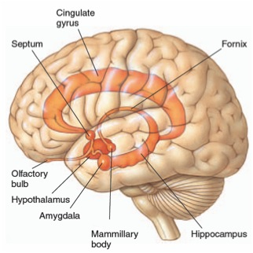
Neuroscience – The Limbic System

Slide 51
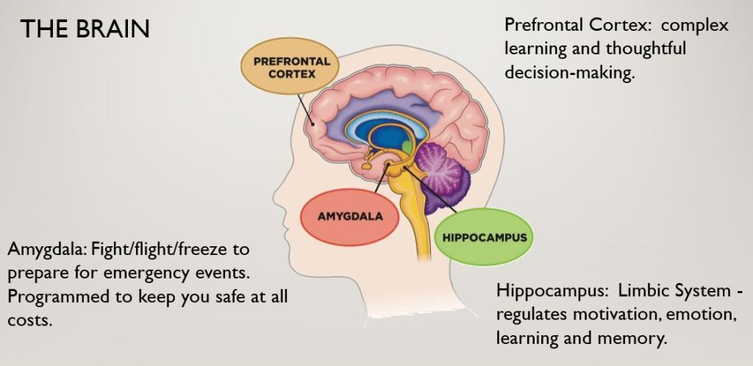

Slide 52
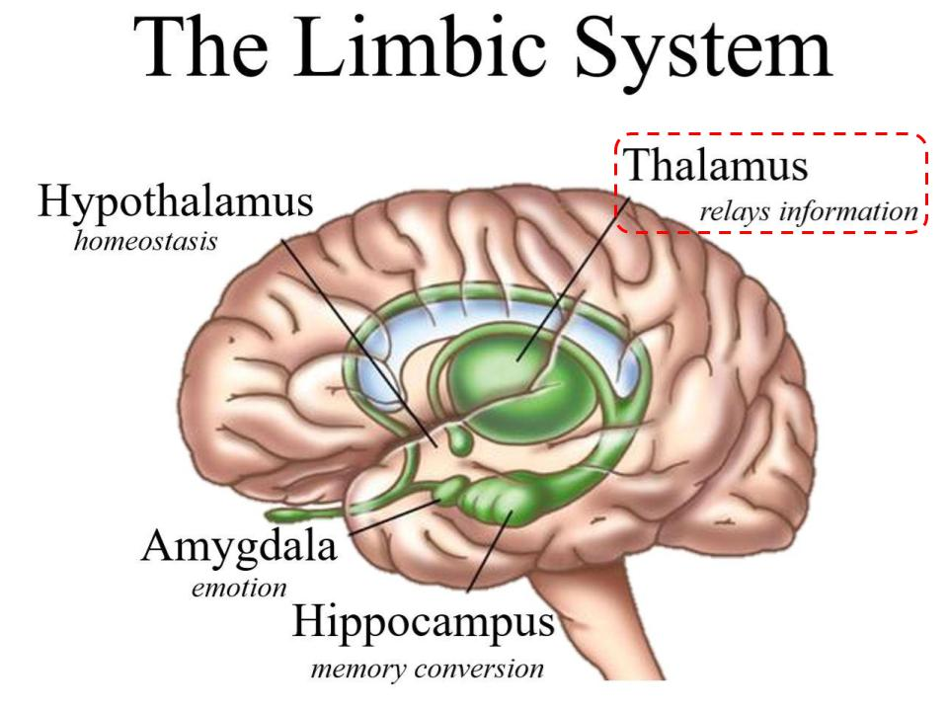

Slide 53
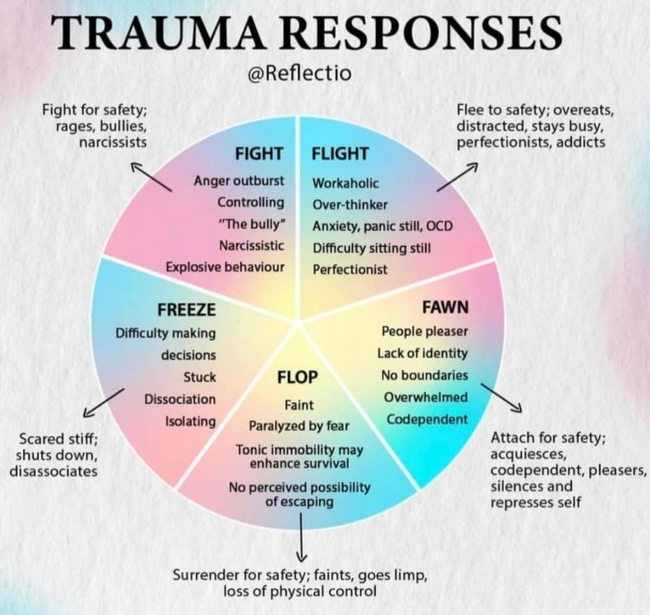
Responses of the Brain & Body During Trauma

Slide 54
Freeze or Dissociation
Defense mechanism (of the brain) to protect against overwhelming sensations & emotions
  Occurs automatically, without trying
Portions (i.e., memories) of an experience that are normally linked together become “dis-associated”
Examples (during & immediately following a trauma):
  “Blanked out” or “spaced out” – in some way felt that I was not part of what was going on
  What was happening seemed unreal to me – like I was in a dream or watching a movie or a play
  Felt “disconnected” from my body

Slide 55
Flop or Tonic Immobility
Uncontrollable response
Mentally know what’s happening but physically unable to move (like being awake during surgery)
Rate of occurrence
  12 – 50% victim/survivors of rape experience tonic immobility during assault (most studies are closer to 50%)
Caused by:
  Fear
  Physical restriction
  “Perceived” inability to escape

Slide 56
Autonomic Responses and the Body
Physiology
  Heart rate, respirations, dilated pupils, dry mouth, knot in the stomach
Affective (mood and emotion) responses
  Fear, helplessness, horror
Cognitive (thought) processing
  Memory – fragmented, out of sequence
  Time distortion
  Increased confabulation
  Trauma memory and recall

Slide 57
Memory phenomenon in traumatic situations
During trauma incident: Sensory overload, fixation on a particular aspect, miss other things
Immediately after: “post incident amnesia”—failure to remember most of what was observed
After a healthy night’s sleep: “memory recovery”—result in remembering majority of what occurred; probably most ‘pure’ recollection
Within 72 hours: final & most complete memory—but at least partially reconstructed after normal process of integrating other sources of information
By Lt. Col. Dave Grossman & Bruce K. Siddle
The Firearms Instructor: The Official Journal of the International Association of Law Enforcement Firearms Instructors
Issue 31 / Aug 2001

Slide 58
Impact of Trauma on Victim/Survivor Behavior
The effects of trauma can influence behavior of a victim/survivor during an interview
People are often reluctant to recall experiences that evoke negative feelings and emotions such as anger, fear, humiliation, or sadness
--Strand, 2013

Slide 59
Parallel Proceedings
Independent from any civil or criminal proceeding
Not required to delay, and in most cases should not delay due to other proceedings
May contact prosecutor/law enforcement to coordinator when feasible
Gather available information:
  Police Report
  Court records

Slide 60

Best Practices
Rely on the policy and procedure
Adhere to the policy and procedure
Let the evidence lead you

Slide 61
Part 3: Interviewing Approaches

Slide 62
Trauma Informed and Human Centered
Empathy and validation
Reinforce agency and choice
Set clear boundaries
Consider the centrality of identity

Slide 63
Trauma Informed Preparation
Developing questions in a way that does not assign responsibility, blame, or guilt
Creating safe and comfortable interview environment/setting
Check your bias especially when reflecting credibility
Consider questions that speak to the senses
Framing and phrasing meeting invitations, email communications
Understand and attend to your own reactions or triggers

Slide 64
Trauma-Informed Approach
Pre-interview framing: “it’s okay if you don’t remember something today,” “sometimes it takes time to remember, which is okay”
  Also clarify: “if you don’t remember yourself but your friends told you that’s what happened, please share that”
Let Complainant talk uninterrupted and ask clarifying questions afterwards
  Consider explaining questions (e.g. “I’m trying to image that”)
  Avoid asking “why” and victim-blaming; instead “tell me more” or “what do you remember next”
Consider asking questions about the other senses
  Is there any smell about the room that you remember?
  Do you recall what color the walls or bed was?
  Were there any sounds or noises that you remember– music? Voices?
Do not insist in chronological order retelling; gather the information and organize it

Slide 65
Significant Time Between Incident And Report
The norm when the person causing the harm was not a stranger
Many victim/survivors are able to report only after they receive the necessary support to do so
Why do they wait? For many of the same reasons they later recant
  They fear repercussions
  They are pressured by others not to report
  They feel shame, embarrassment
  They are afraid of the person who caused the harm
  They are afraid of not being believed
  Fear that nothing will be done about it

Slide 66
Cultural Considerations
Communication styles
Attitudes toward conflict
Approaches toward completing tasks
Decision-making styles
Approaches to knowing
Attitudes toward disclosure
  Appropriate to share emotions, reasons for conflict
                --Sue Ann Van Dermyden, 2017

Slide 67
Common Practice Considerations
Be mindful of cultural differences
  Continuum of honesty and face-saving
  In-group vs. out-group
  Linear vs. non-linear narrative
Check biases, especially when assessing credibility
Ask questions in a way that does not assign responsibility, blame, or guilt

Slide 68
Investigation Clarification
Policy elements
  Components defined
  Evaluation considerations
Evidence and credibility
For 1B.3.1 (Title IX) Consent construct
  Force
  Incapacity
  Consent

Slide 69
Determine goals of questions
Who, what, where, when, why, how
Intake meeting vs. Investigatory interview
Refine scope
What information are you missing or have questions
  Read through reports/complaints and note any questions
Policy elements
  Policy element handout

Slide 70
How to structure questions
Start with broad/open ended questions
Allow to tell their story/experience however they choose
  Where they start/end their story and what they emphasize can be very telling and important for you to have.
Clarifying questions
  Funnel approach
  Ask to clarify meaning of words/descriptors
Allow for Silence
Additional questions/things left unanswered
Closing questions
  Is there anything else you think I should know?
  Anything I didn't ask that you thought I would ask about?
  Is there anyone that you think I should talk to? Why?

Slide 71
Interview questions for ALL
Interview questions for all parties
  Allow them chance to share their story/experience
    "Tell me about your experience" - "this is your opportunity to respond to allegations" - "do you know why I asked to meet with you"
    Prepare what information willing/able to share
  Ask the who/what/where/when/how questions
  Summarizing Information back
  Policy elements
  Effect/impact

Slide 72
Interview questions continued...
Interviewee specific questions
  Respondent – make sure to review allegations before questions
    Make sure the respondent has an opportunity to speak to each individual allegation
  Complainant – clarify protected class and identity
  What they observed/their perspective of incident(s)
  Inconsistencies with other parties/witnesses
  Evidence specific questions – what they have, might have seen/been part of, etc.
  Desired outcome/resolution

Slide 73
Assessing Credibility

Slide 74
Interview Considerations For credibility
Look for consistency with out-cry witnesses or contemporaneous reports
Assess demeanor
Inherent Plausibility
  Consider relevant past acts; are there alternative versions that are more plausible
Compare overlap/consistency with other statements
Interviewee who derails questions and/or focuses on irrelevant information
Providing inconsistent statements
Motives/Relationships
Positionality
Mind/memory altering substances

Slide 75
Analyzing certain qualities and factors
Demeanor: noted reactions to allegations or information shared; behaviors or feelings shared with others
Logic and consistency: consistency with what others shared (including possible witnesses); plausible explanations
Corroborating evidence: any admission or rationalizing of conduct; specific denial; witnesses with the opportunity to observe, recognize, or understand the situation
Circumstantial evidence: statements or behavior in other situations that support or refute alleged conduct
Trauma-informed approach: note that trauma itself is not evidence to support or not support

Slide 76
Breakout session 3
Review witness summaries
Update investigation roadmap
  What follow-up questions do you have for Complainant and witnesses?
  What questions do you want to ask Respondent?

Slide 77
Conducting interviews

Slide 78
Each interview might look different
Emotion – crying, anger, indifference, being conflicted, shock, trauma, etc.
Timing – short answers, decisions to make, communication styles, etc.
How you ask questions
Credibility concerns
Effort needed to structure interview – redirect, diffuse conversation, etc.

Slide 79
Maintaining control of interview
Provide roadmap of interview
Safety – Think about how you have arranged the room, security, etc.
Union reps/ support persons/parents/lawyers
  Be clear about what their role is [ I.e., don't ask interview questions and don't answer questions) from the very beginning (include in letters; share in speech)
    Communicate to party and support person (if appropriate)
  Allow for time and space for them to meet away from investigator (separate room; breakout room, etc.)
  Give reminders/warnings if necessary
Don’t be afraid to end a meeting
Difference between control and parties not cooperating

Slide 80
Providing empathy and validation
Empathy for all interviewees
  Focus on treating the individual as a whole person
  Develops rapport and shows respect for your story/experience
  Reduces resistance and allows them to share in supportive environment
Remain neutral
  Don't confuse/misuse as a way to justify actions or suggest leniency in consequences
  Don't relate to your own personal experiences (this is not about you)
Needs to be sincere and genuine
  Develop your own style
  Practice using sample language that validates a person's experience but remains impartial
Remember to allow space for decisions

Slide 81
Challenging interviewee tropes
The Clueless one
The Denier
The Distractor
The Confessor
The Explainer
The Apologetic one
The TV lawyer
The Avoidant one
The Questioning one

Slide 82
Breakout session 4
1-2 ppl play investigator and conduct the interview
  Consult your investigation roadmap for Respondent questions
  Draft actual questions for the Respondent

Slide 83
Breakout session 4
Role play Respondent interview
  1-2 ppl from each group play Respondent and pick a trope to play
  Take a minute and think about what questions they might ask and how you might decide to respond consistent with the trope

Slide 84
Recording and Note taking

Slide 85
Note taking
Handwritten, typed, Teams transcript
Some of this is a personal preference – be consistent
Have outline of meeting/interview
Consider a notetaker for support
Model notes after investigation report
Make notations where you still have questions for follow up or for other parties

Slide 86
Common challenges & tips
Common challenges
  parties talk fast or talk in circles/share repetitive information
  interviews are long
  prioritizing typing notes after interview
  Self-care
Tips
  type notes/update as soon as possible after interview
  document thoughts for follow up
  have a notetaker
  encourage all to submit a written statement

Slide 87
Recording interviews
Allows the investigator to focus on content/information and being present during the interview
Recordings can ensure that all data and information is accurate.
  Provides for use of direct quotes
  Allows for investigator to review/reflect to determine what gaps still exist
  Provides investigator an opportunity to refine investigation skills
Recordings can be taken in multiple ways
  Teams, handheld, etc.
Record ALL the interview - including opening information, data privacy review (ask for verbal acceptance), all "housekeeping" information

Slide 88
Recording interviews, cont.
There are additional nuances of recording that are different from standard interviewing.
  Open recording stating date, time, and introduction of parties (including spelling of names). End recording with time.
  Audio recordings do not pick up on non-verbal (head nods, etc.) – prepare parties at beginning of interview and clarify during interview if needed.
Develop a plan for your recording - send for transcription, etc.
  This provides a typed/hard copy of the interview.
Transcription review
  Determine if you want to add this as a part of your process
  Who can attend to complete the review

Slide 89
Recording considerations
Contracts for transcription
  REV.com, other transcription services.
Access to transcripts
  Who, when, why
Storage of recordings and transcripts
Data retention policies

Slide 90
Part 4: Components of Investigation Report

Slide 91
Goals of Investigatory report
Present findings in a well-written and well-organized format
Document the steps taken during the investigation
Document the evidence collected and reviewed
Provide a clear, objective picture of investigation to the DM
Should contain all information a DM needs to make their decision

Slide 92
Investigatory report components
Transmittal letter & Cover Sheet/Disclosure Notice
Investigation report cover page
Table of contents
Introduction
Scope & Methodology
Policies & Definitions
Statements & Evidence
Synthesis
Exhibit Index

Slide 93
Transmittal letter
Introduction of the investigation to DM
Investigators contact information
Indicates the completion of investigation and next steps for DM
Include Data Practices Disclosure Warning

Slide 94
Investigation report cover page
Report Date
Report prepared for: Decision-maker
Report prepared by: Investigator
Nature of investigation: Allegation of 1B.1 Nondiscrimination
Complainant(s): Name and status
Respondent(s): Name and status

Slide 95
Table of Contents
Organize by sections and subsections
Use a numbering/lettering system
  Letters, numbers, roman numerals
  Avoid bullet points
Include page number for each section
This is the last page you will update on your report

Slide 96
Introduction
Report synopsis:
  Rationale or basis of the investigation
Summary of allegations:
  Identify complainant and respondent
  Summarize the allegations, including specific details
Investigation context: relevant procedure followed

Slide 97
Scope & methodology
Details of the report/complaint
  Initial report
  Formal complaint
  Investigation initiated
Jurisdiction
Scope of investigation
Involved parties, interviews, procedural steps
  Includes dates of notices, meetings and submissions
  Relationship between Complainant(s), Respondent(s), and Witnesses
    Inform by journal of action
  Investigation timeline

Slide 98
Applicable Polices & Definitions
Policies and procedures
  Copy and paste relevant parts of policy and procedure
Standard of Evidence
  Preponderance of evidence - "more likely than not"

Slide 99
Evidence
Interview summaries
  Use quotes
  If pronouns are used in a quote, use brackets to indicate who is in reference
    Ex: “I told him [Witness 2] about the next day”
  Can also be a space to document witness and interview decisions
  May need to reorganize interview statements
    Chronological; by allegation
  Summary vs. Recitation
  Investigator's note
    Can note meeting information (format, individuals present, etc.)
    Can be a way to embed credibility information
  Cite to exhibits
    If supported by exhibit, cite to it
Evidence gathered

Slide 100
Synthesis
Questions being presented for DM
Investigative synthesis
  Written as a narrative
  Puts all the interview summaries and evidence together – synthesizes the information
  Support with citations to statements and exhibits when relevant
  Embed credibility information
  Address gaps, missing information, etc.
  "IRAC" format
  Different ways to organize this section:
    Issue by issue
    Chronologically
    By individual
Disputed and undisputed facts

Slide 101
Assessing and Explaining Credibility
  Not charged with definitively determining truth over fabrications
    Instead, preponderance of the evidence
  Does witness statement or evidence support one account over another?
  Can statements be corroborated?
  Is there consistency or a lack of consistency in statements?
  Is there potential bias in a statement?
  Has important testimony or material been omitted?

Slide 102
Conclusion
Case disposition – to whom/where the report goes to next
Location of case files, original evidence, notes, etc., should they be needed
Informing the DM of option to request additional information or investigatory steps should they deem them needed
Conclusion should not include:
  Policy violation findings
  References to laws or illegal behavior
  Recommendations
  Decisions or outcomes

Slide 103
Technical vs objective writing
Technical Writing
Focuses on explaining complex concepts clearly
Instructional, procedural, and often involves guidelines/manuals
Primary goal is to make technical information easy to understand and use
Written for a specific audience

Slide 104
Technical vs objective writing, Cont.
Objective Writing
Impersonal and factual
Focuses on being neutral and informative, ensuring the reader can make their own judgments
Focuses on credibility but avoids overt persuasions
Presenting facts without bias
Written for a general audience

Slide 105
Technical vs objective writing
Comparing technical and objective writing:
Both require clarity, structure and accuracy
Both are focused on fact-based and credible information
Share a purpose to explain or instruct without bias
Best practices:
Be concise and avoid unnecessary complexity.
Stick to facts and connect to relevant exhibits attached to investigatory report
Avoid language that can be misinterpretted

Slide 106
Assignment to Decisionmaker
DM Assignment Memo - Introduction of the investigation to DM
  Investigators contact information
  Parties' contact information
DM Checklist
MoveIT Securely Instructions
Investigation report and exhibits
Notice of DM Assignment sent to Complainant(s) and Respondent(s)
Update internal tracking
Copies to system office

Slide 107
Breakout session 5
Draft an outline for your investigative synthesis section and use the following information:
  Information from progressive scenario handout
  Information shared during respondent role play
  What additional evidence you collected....use your imagination!

Slide 108

Thank you.
30 East 7th Street, Suite 350
St. Paul, MN 55101-7804
651-201-1800
888-667-2848
MinnState.edu
This document is available in alternative formats to individuals with disabilities. To request an alternate format, contact Human Resources at 651-201-1664.
Individuals with hearing or speech disabilities may contact us via their preferred Telecommunications Relay Service.
Minnesota State is an affirmative action, equal opportunity employer and educator.

