Slide 1
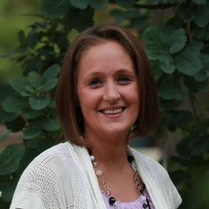
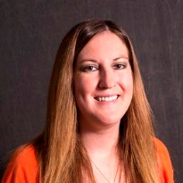
SMSU College Now Summer Workshop
August 4, 2020
NACEP Accreditation Approval
2017-2023
Kimberly Guenther
Director
507-537-6709
Kim.Guenther@smsu.edu
Jessica Mensink
Assistant Director
507-537-6390
Jessica.Mensink@smsu.edu
Ellie Ahmann
Expansion Coordinator
507-537-6138
Ellie.Ahmann@smsu.edu

Slide 2
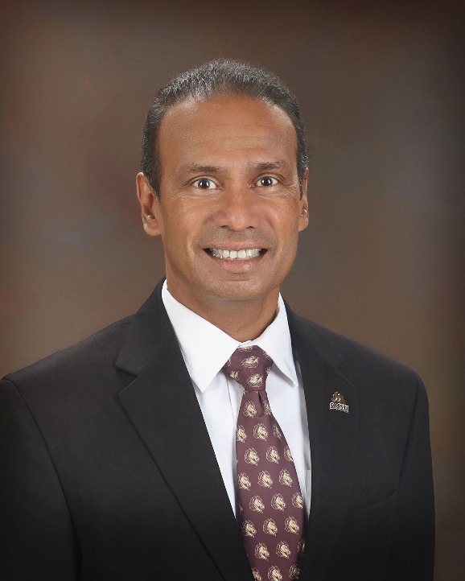
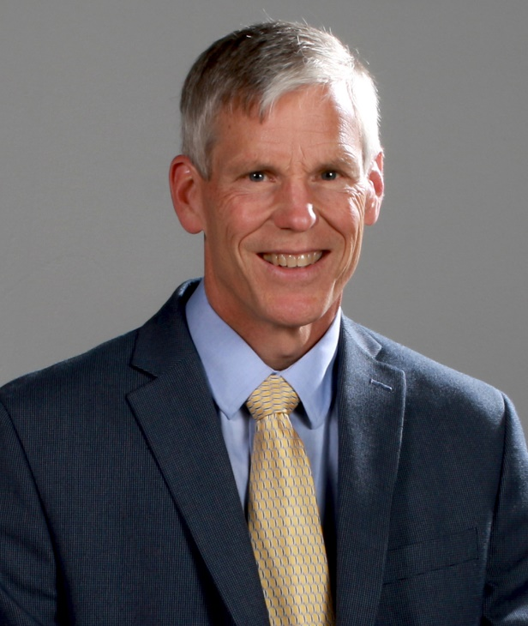
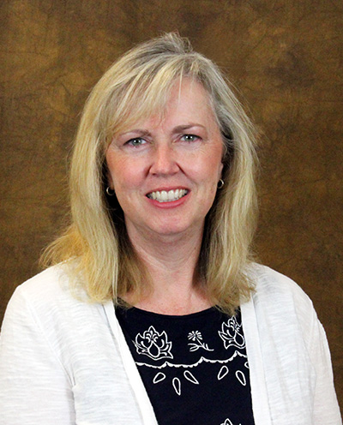
Welcome
Dr. Kumara Jayasuriya
President
Dr. Ross Wastvedt
VP for Academic and Student Affairs
Dr. Aimee Shouse
Dean of College of Arts Letters and Sciences

Slide 3
Today’s Schedule:
8:30-9:45 – Welcome and Concurrent Enrollment Updates
9:45 –10:00 – Break (before taking break, you MUST log into the links below)
10:00 – Academic Sessions
9:45, Math/Computer Science/IDST teachers, you will sign in here: https://minnstate.zoom.us/j/95440876518
9:45, all other academic disciplines (Art, Biology, Chemistry, Communications, Economics, Education, English, Geography, Literature, Management, Music, Physics, Political Science, Sociology, Spanish), will sign in here: https://minnstate.zoom.us/my/ellie.ahmann
Psychology will be done for today after the opening session.
Superintendents, Principals, Counselors, and other administrators will stay on this call for a longer questions and answer session.

Slide 4
The compliance date has been pushed back one year due to COVID –
September 1st, 2023
Credentialing qualifications remain the same;
Master’s degree in discipline
Master’s degree in any discipline with 18 credits in discipline

Slide 5
Minnesota State Colleges & Universities System Comprehensive Plan for Faculty Credentialing and Program Sustainability:
Minnesota State System Committee
Contracted with Distance Minnesota
Moorhead Online 18
Metro ECSU: SMSU MSU Mankato
Credit for Prior Learning (CPL): Fall 2020
Chemistry, Biology, Physics, English, Communications

Slide 6
Credentialing Review
We will be sending out an updated credentialing overview for every teacher around the end of October showing the number of courses we have recorded teachers have completed. Will go to teachers and principals.
If you have completed new coursework not yet included in review, you can send us that at any time. We generally send information to departments twice a year for review (November and March)
SMSU and other MinnState University courses - we can pull for free, let us know those courses are there
We can review off of unofficial transcripts, but will need official copies eventually in your file for HLC.
You can wait until all courses are complete at a given University before sending us official transcripts.

Slide 7
COVID-19 / Distance Learning
We’ll leave majority for academic – faculty can guide you on resources and expectations
We’ll continue to be flexible whenever and wherever possible especially in regards to schedules, modalities, and certain modifications
Rigor, assessments, outcomes etc. have to remain at the college level and meet SMSU approval. We are accredited by the Higher Learning Commission and the National Alliance of Concurrent Enrollment Partnerships, so all standards must remain the same.
Grading
Letter vs Credit/No Credit
Other Resources:
https://www.smsu.edu/colt
Zoom
Kaltura MediaSpace
D2L
Respondus

Slide 8
Cheers to a great upcoming year, regardless of the schedule, modality or modifications.
Jess will discuss student registration, student eligibility, our new student appeal process, and more.

