Slide 1
2020 Election Registration and Voting Information
SMSU’s Campus Election Engagement Project Student Fellows:
Isabella Erickson & Carter McLaughlin

Slide 2
Voter Registration
Are you registered to vote? Not sure?
  Check your current registration status and location (any state) in 30 seconds at vote.org
Need to register? Early registration is closed, BUT…
  Register or update voter registration in person on Election Day – Tuesday 11/3
  If living on campus: Only need your Student ID
  If living off campus: See Election Day TS below.
Helpful information for Student Voters
  From the MN Secretary of State: College Students 2020 Tip Sheet, Election Day Registration Tip Sheet

Slide 3
Sample Ballot
&
Candidate Info
Not sure what or who to expect on your ballot?
  View your sample ballot at mnvotes.org
    Only need your physical address
  Find easily accessible, nonpartisan information about each candidate at votereducationweek.org
    Will need your physical address AND email (sort of)
    Make your picks then email or print them off. *This is NOT your actual ballot.
Helpful information for Student Voters
  View a sample ballot for Marshall, MN here

Slide 4
Voting Options
Vote in person
  Easily search for your local polling station at mnvotes.org (MN voters) or at vote.org (non-MN voters)
Vote by mail
  Request your absentee/mail-in ballot at vote.org (non-MN voters) or mnvotes.org (MN voters)
  Registered voters need no witness signature on ballot this year
  For MN - Need not be registered to request, BUT will need a witness signature when completing ballot to verify residency
  Ballot envelope must be postmarked by Election Day 11/3, and received w/in 7 days by 11/10
Vote early in person
  Available at your local election office. Find yours at the MN Secretary of State website, or find your local state’s Secretary of State website here
  MN – Available September 19th – November 2nd
Need Assistance or Special Accommodations? Help is available!
  2020 Voter Assistance Tip Sheet, 1-877-600-VOTE

Slide 5
Final Tips
Check the status of your absentee ballot:
  Verify that your ballot was received and counted here (MN voters), or see if your local state provides tracking services here
Marshall Community Transit is free for students with your Mustang ID. Refer to their website for Red and Blue route information and hours of service
Remember that your vote counts! No matter who you vote for. Get out there and exercise your right ☺
If you have any questions, comments, or concerns regarding voting, please feel free to reach out to us: carter.mclaughlin@my.smsu.edu
Isabella.Erickson@my.smsu.edu

Slide 6

Election Protection Hotline
866-OUR-VOTE (866-687-8683)
866ourvote.org

Slide 7
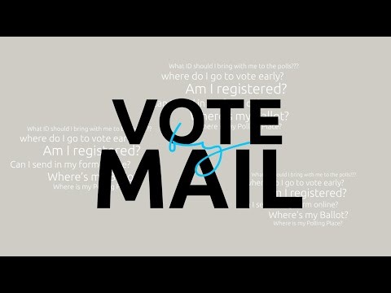
How to Vote by Mail studentsunited.org

